Slide 1
Lead Scoring – Case Study

Slide 2
Problem Statement
X Education sells online courses to industry professionals. The company markets its courses on several websites and search engines like Google.
Once these people land on the website, they might browse the courses or fill up a form for the course or watch some videos.
When these people fill up a form providing their email address or phone number, they are classified to be a lead.
Moreover, the company also gets leads through past referrals.
Once these leads are acquired, employees from the sales team start making calls, writing emails, etc.
Through this process, some of the leads get converted while most do not.
The typical lead conversion rate at X education is around 30%.

Slide 3
Business Goal
X Education needs help in selecting the most promising leads, i.e. the leads that are most likely to convert into paying customers.
The company needs a model wherein you a lead score is assigned to each of the leads such that the customers with higher lead score have a higher conversion chance and the customers with lower lead score have a lower conversion chance.
The CEO, in particular, has given a ballpark of the target lead conversion rate to be around 80%

Slide 4
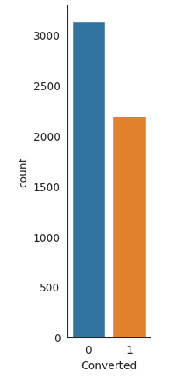
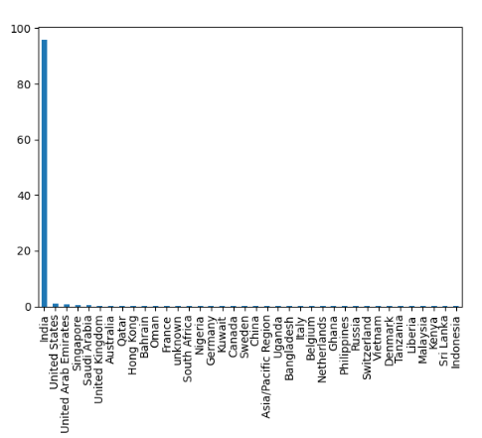
Exploratory Data Analysis
We have around 39% Conversion rate in Total
Major traffic is from Indian customers only

Slide 5
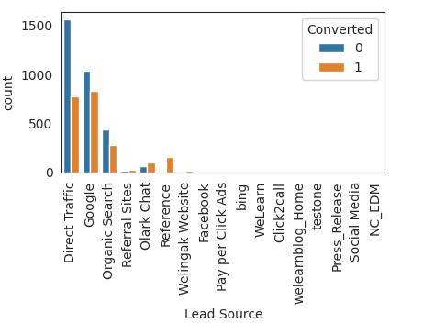
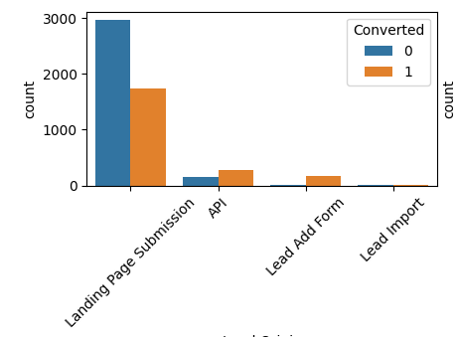
In Lead Origin, maximum conversion happened from Landing Page Submission
Major conversion in the lead source is from Google

Slide 6
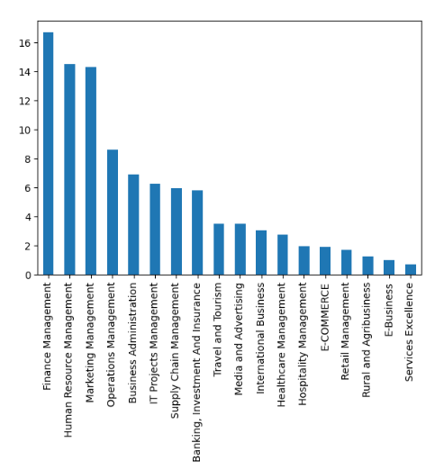
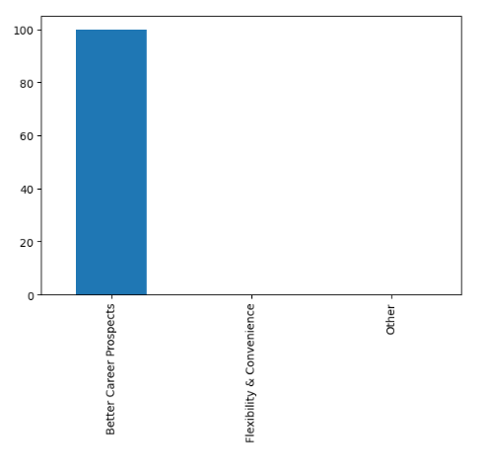
All management related courses seems to be more interesting, and people are mainly looking at these courses for better career prospects.

Slide 7
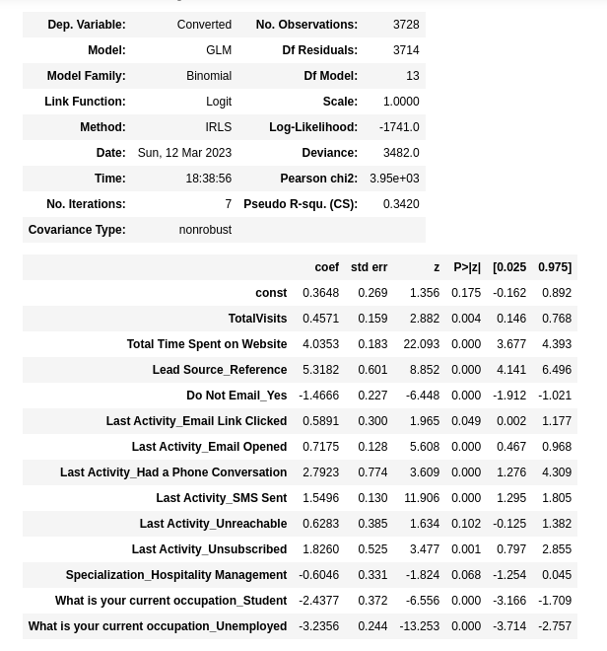
Model Evaluation

Slide 8
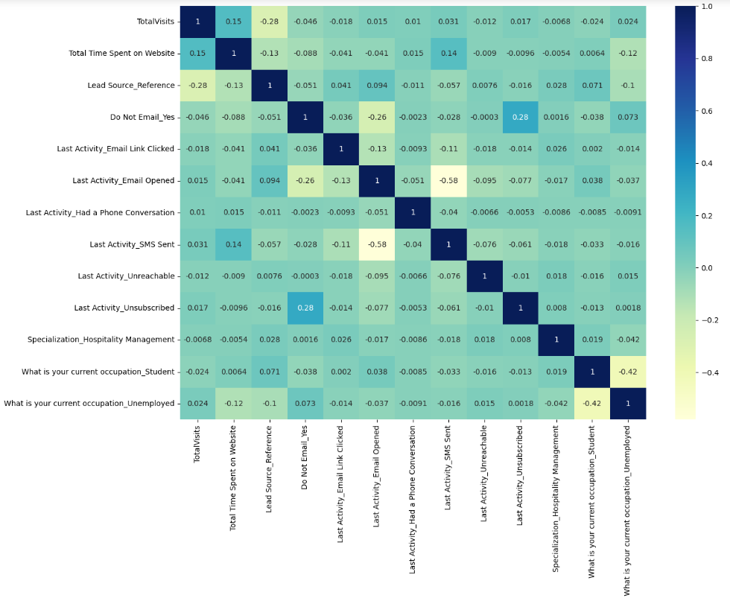
Correlation Matrix

Slide 9
Conclusion
While we have checked both Sensitivity-Specificity , we have considered the optimal cut off based on Sensitivity and Specificity for calculating the final prediction at 0.4
The overall accuracy of the prediction is around 79% calculated using trained set.
Also the lead score calculated shows the conversion rate on the final predicted model is around 79% (in train set) and 78% in test set
Below are the top 3 variables that contribute for lead getting converted in the model are
Total time spent on website
Lead Source - Reference
Last Notable Activity - Had a Phone Conversation
The model on an overall level seems good

